Slide 1
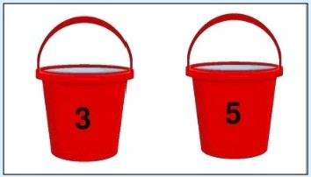
Question-1 : You have two buckets - one of 3L and other of 5L. You are expected to measure exactly 4L. How will you complete this task? Note: There is NO third bucket Answer-1 : Step-1: Fill in the 5L bucket and empty in 3L bucket Step-2: Empty the 3L bucket and pour contents of 5L bucket in it. Step3: Fill 5L bucket and pour in 3L bucket

Slide 2
Supervised Learning
Uses known and labeled data as input
Supervisedlearning has a feedback mechanism
Most commonly used supervised learning algorithms are decision tree, logistic regression, support vector machine
Unsupervised Learning
Uses unlabeled data as input
Unsupervised learning has no feedback mechanism
Most commonly used unsupervised
learning algorithms are k-means clustering, hierarchicalclustering, apriori algorithm

Slide 3
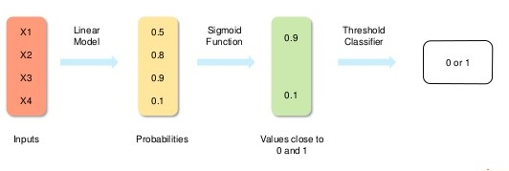
Logistic Regression measures the relationship between the dependent variable (our label, what we want to predict) and the one or more independent variables (our features), by estimating probabilities using it's underlying logistic function (sigmoid)

Slide 4
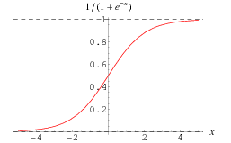

Slide 5
STEPS:
Take the entire dataset as input Calculate entropy of target variable as well as predictor attributes.
Calculate information gain of all attributes.
Choose the attribute with highest information gain as the root node.
Repeat the same process on every branch till the decision node of each branch is finalized.

Slide 6
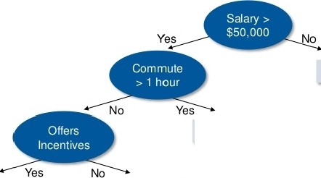
For example,if you want to build a decision tree to decide whether we should accept or decline a job offer
Decline Offer
Decline Offer
Accept Offer
Decline Offer

Slide 7
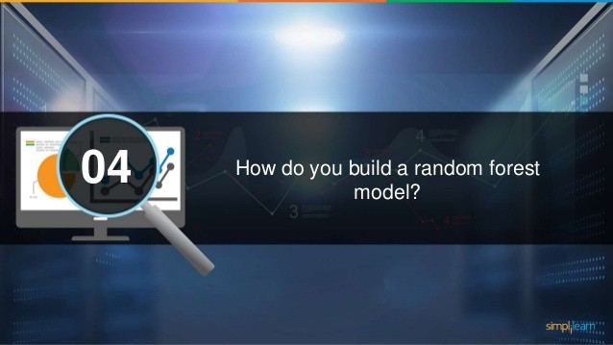

Slide 8
STEPS
Randomly select “k” features from total “m” features Where k << m
Among the “k” features, calculate the node “d” using the best split point
Split the node into daughter nodes using the best split.
Repeat steps 2 and 3 steps until leaf nodes are finalized.
Build forest by repeating steps 1 to 4 for “n” number times to create “n” number of trees

Slide 9



There are three main methods to avoid overfilling:
Use regularization techniques such as LASSO that penalize certain model parametersif they're likely to cause
overfill i ng
Keep the model simple: take into account fewer variables, thereb,y
Use cross-validation techniques such as k-folds
cross-validation
removing some of the noise in the training data
...._

Slide 10
Question-2 : There are 9 balls out of wh ich one b all is heavy i n weight and rest are of the sameweight. In how many minimum Weightings will you find the heavi er ball?
Answer-2 : You will need to perform 2 weightings:
Step 1:Place three balls on each side
Scenarlo(a): Balance out
Out of the remaining three balls from step 1,take two balls and place one ball on each side - tt they balance out then the left out ball will be the heavier ball.Otherwise,you will see it in the balance.
Scenarlo(b): Not balanced out
If the balls in step 1 do not balance out, then take those three balls and reproduce step 2 to f ind out the heavier ball.

Slide 11
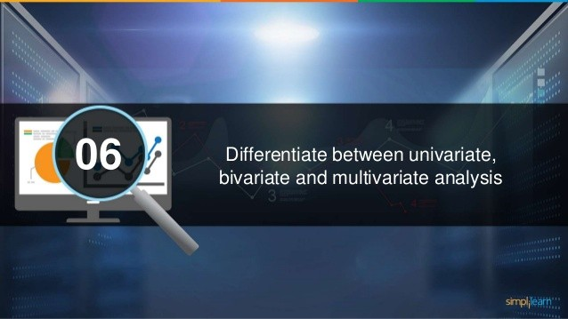

Slide 12
Height (in cm)
164
167.3
170
174.2
178
180
This type of data contains only one variable. The purpose of univariate analysis is to describe the data and find patterns that exist
Example: height of students
The patterns can be studied by drawing conclusions using mean, median and mode, dispersion or range, minimum, maximum etc

Slide 13
This type of data involves two different variables. The analysis of this type of data deals with causes and relationships and the analysis is done to find out the relationship among the two variables
Example: temperature and ice cream sales in summer season.
Here, the relationship is visible from the table that temperature and sales are directly proportional to each other Temperature
Temperature (in Celsius} | Sales
20 | 2000
25 | 2 100
26 | 2300
28 | 2400
30 | 2600
35 | 3 100

Slide 14
When the data involves three or more variables, it is categorized under multivariate.
It is similar to bivariate but contains more than one dependent variable
No. of rooms | Floor | Sqft. Area | Price
2 | 0 | 900 | 40,00,00
3 | 2 | 1100 | 60,00,000
3.5 | 5 | 1500 | 90,00,000
4 | 3 | 2100 | 1,20 ,00,000
Example: Data for house price prediction
The patterns can be studied by drawing conclusions using mean, median and mode, dispersion or range, minimum, maximum etc

Slide 15


There are two main methods for feature selection:
Filter Methods
Wrapper Methods
Linear Discriminant Analysis
Forward Selection
ANOVA
Backward Selection
Chi-Sqaure
Recursive Feature Elimination

Slide 16


Slide 17
for fizzbuzz in range(1,5l):
if fizzbuzz % 3 == 0 and fizzbuzz % 5 == 0:
print("fizzbuzz") continue
elif fizzbuzz % 3 == 0:
print("fizz")
continue
elif fizzbuzz % 5 -- 0: print("buzz") continue
print (fizzbuzz)
Code:

Slide 18
Question: You are given a dataset consisting of variables having more than 30% missing values? How will you deal with them?
Ways to handle missing data values:
If dataset is huge, we can simply remove the rows with missing data values. It is the quickest way i.e. we use the rest of the data to predict the values.
We can substitute missing values with mean of rest of the data using pandas dataframe in python i.e. df.mean() df.fillna(mean)

Slide 19
Question: For the given points, how will you calculate the Euclidian Distance, in Python?
Given points: plot1 = [1,3]
plot2 = [2,5]
Ans: euclidean_distance = sqrt( (plot1[0]-plot2[0])**2 + (plot1[1]-plot2[1])**2 )

Slide 20
Question: What is the angle between the hour and minute hands of a clock when the time is half past six? Can you solve?
Note: A clock is a complete circle having 360 degrees In 1 hour, the hour hand covers: 360/12 = 30° In 1 minute, the minute hand covers 360/60 = 6°
1. The minute hand has travelled for 30 minutes. So, it has covered 30×6=180° .
2. The hour hand has travelled for 6.5 hours. So, it has covered 6.5×30=195°.
3. The difference between the two will give the angle between the two hands. Thus, the required angle=195°-180°=15°

